Slide 1

Department of Information Technology
A.P. Shah Institute of Technology
G.B.Road,Kasarvadavli, Thane(W), Mumbai-400615
UNIVERSITY OF MUMBAI
Academic Year 2020-2021

Slide 2
A Project Report on
Training and Placement Management System
Submitted in partial fulfillment of the degree of
Bachelor of Engineering(Sem-8)
in
INFORMATION TECHNOLOGY
By
Shifa Tamboli(17104069)
Harshita Shah(17104024)
Anita Yadav(17104016)
Under the Guidance of
Mr. Ganesh Gourshete

Slide 3
1.Project Conception and Initiation

Slide 4
1.1 Abstract
The project named training and placement management system, a student/company information system is a web based system.
The project is developed on the basis of III Cell‖ being presently used in the University for storing and retrieving the information of students and companies who are registered in III Cell .
The III Cell maintains a large database of students wherein all the information of student including the personal records and the academic performance is stored and company information including profile of company, eligibility criteria and facilities it provide .
The software retrieves this data and displays as per the user requirement .
The System provides the facility of viewing both the personal and academic information of the student and recruiters.
Admin are responsible for confirming the document of student which means if recruiters or student want to change any detail it would be verified by admin .
Officer will be responsible for selecting student for drives on the basis of their performance in institute based examinations.

Slide 5
1.2 Objectives
Arrange and manage the information and CV’s of students according to various streams.
Recruiters can upload their information and requirements.
To provide Training and Employment opportunities for students.
To provide industry institute interaction.
Save time for the process.
To reduce the manual work .

Slide 6
1.3 Literature Review
Title: Web Based Placement Management System Author: Anjali.V, Jeyalakshmi.PR, Anbubala.R Year:2016
Limitation: This system can be used as an application for the Placement Officers in the college to manage the student information with regard to placement. Student logging should be able to upload their personal and educational information in the form of a resume.
Title: Design Paper on Online Training and Placement System(OTaP), Author: Mr. Nilesh T. Rathod,Prof. Seema Shah, Year:2013
Limitation: The proposed OTaP system gives the automation in all the processes like Registration ,Updation , Searching .It provide the detail solution to the existing system problem
Title: Large-Scale Dynamic Controller Placement Author: Web Based Placement Management System Year:2017
Limitation: Although in this paper we have emphasized the use and the importance of the open search technique to maximize the utilization of controllers, we have also offered an alternative search technique for those scenarios in which the open search technique is not applicable.

Slide 7
1.4 Problem Definition
In various colleges training and placement officers has to collect the information, CV’s of student and manage them properly and arrange them according to various streams and if modification is required it has to be done manually which is a bit tedious.
So, to reduce the job of training and placement officer to manage student and recruiters information new system is proposed which process through the computer Which would be total web based application which will manage and arrange student and recruiters information and provide the facility to upload their document.
Here student can search regarding company information and recruiters can also see the details about college and student.
Basically this web based system would be interactive system.

Slide 8
1.5 Scope
Training Placement Management System is developed as an attempt to take a record of company and students by restricting such a large database to that of a particular class of students or company.
The System provides the facility of viewing both the personal and academic information of the student and company.
Admin can also search for eligible students and company and also the insertion and deletion of records.

Slide 9
1.6 Technology stack
HTML
JavaScript
CSS
Bootstrap
XML
PHP
MySql

Slide 10
1.7 Benefits for environment & Society
It helps and automates the process of Placement.
Student screening can be done based on selection criteria.
Placement companies for Recruitment can see the record of all the correspondence.
The students can be notified easily for various placement rounds.
It reduces manual paperwork which is very much beneficial for environment.

Slide 11
2. Project Design

Slide 12
2.1 Proposed System
The aim of the proposed system is to develop a system with improved facilities.
The proposed system can overcome all the limitation of the existing system, such as student’s information is maintained in the database, it gives more security to data, ensures data accuracy, reduces paper work and save time, only eligible students get chance, it makes information flow efficient and paves way for easy report generation, reduce the space.
Proposed system is cost effective.

Slide 13
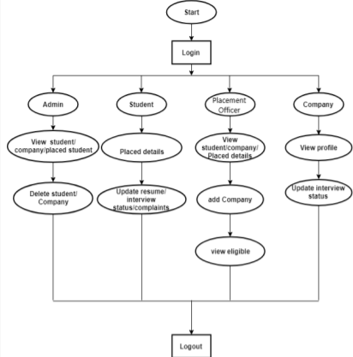
2.2 Design(Flow Of Modules)

Slide 14
2.3 Description Of Use Case
The system consists of four modules as admin module, student module, faculty module and recruiter module. Each module has an login page that contain user id and password field, by entering value in that field the user should login to the system:
1.Admin:Admin can add/remove faculty,student or recruiter.He can also view any changes made by others.And can also create drive and decide no. of rounds included in that drive.
2.Faculty:Faculty will verify the data and documents of each student and will approve that.After verification, if any student makes any,that will be shown to the faculty again for the approval.Faculty will register the student in drive based on the required criteria.
3.Recruiter:Recruiter can also create a drive.They can also search students according to their requirement/criteria.Recruiters can also view the Home page.
4.Student:Students can to fill up the required personal details,educational details,etc along with the required documents.They can also view the Home page,where all the upcoming drives,notice etc will be visible.

Slide 15
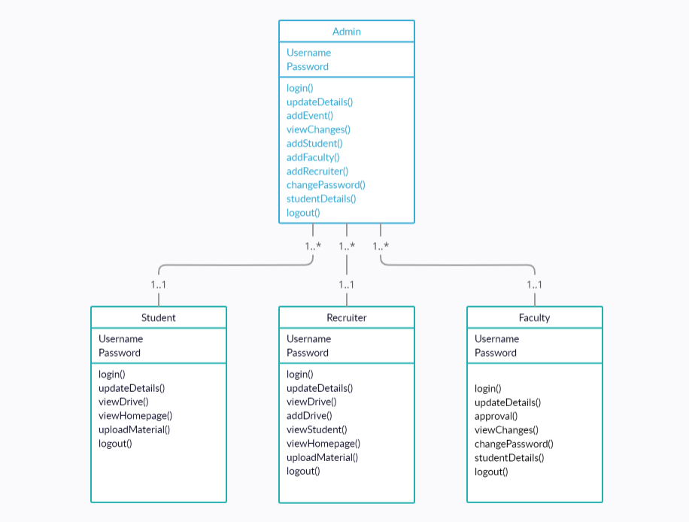
2.4 Class diagram

Slide 16

2.6 Module-1
Home-page

Slide 17
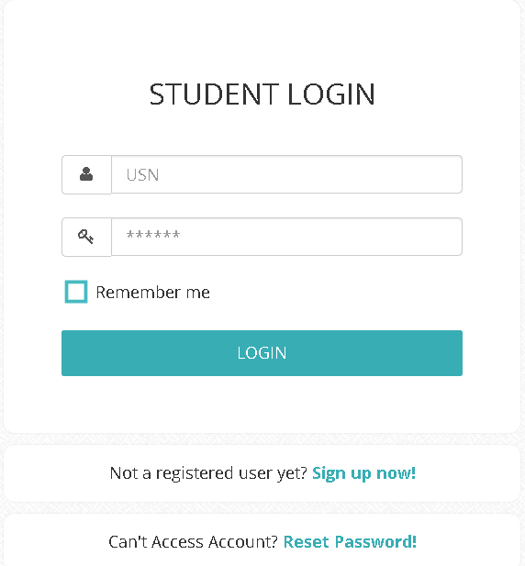
Module-2
Student Login

Slide 18
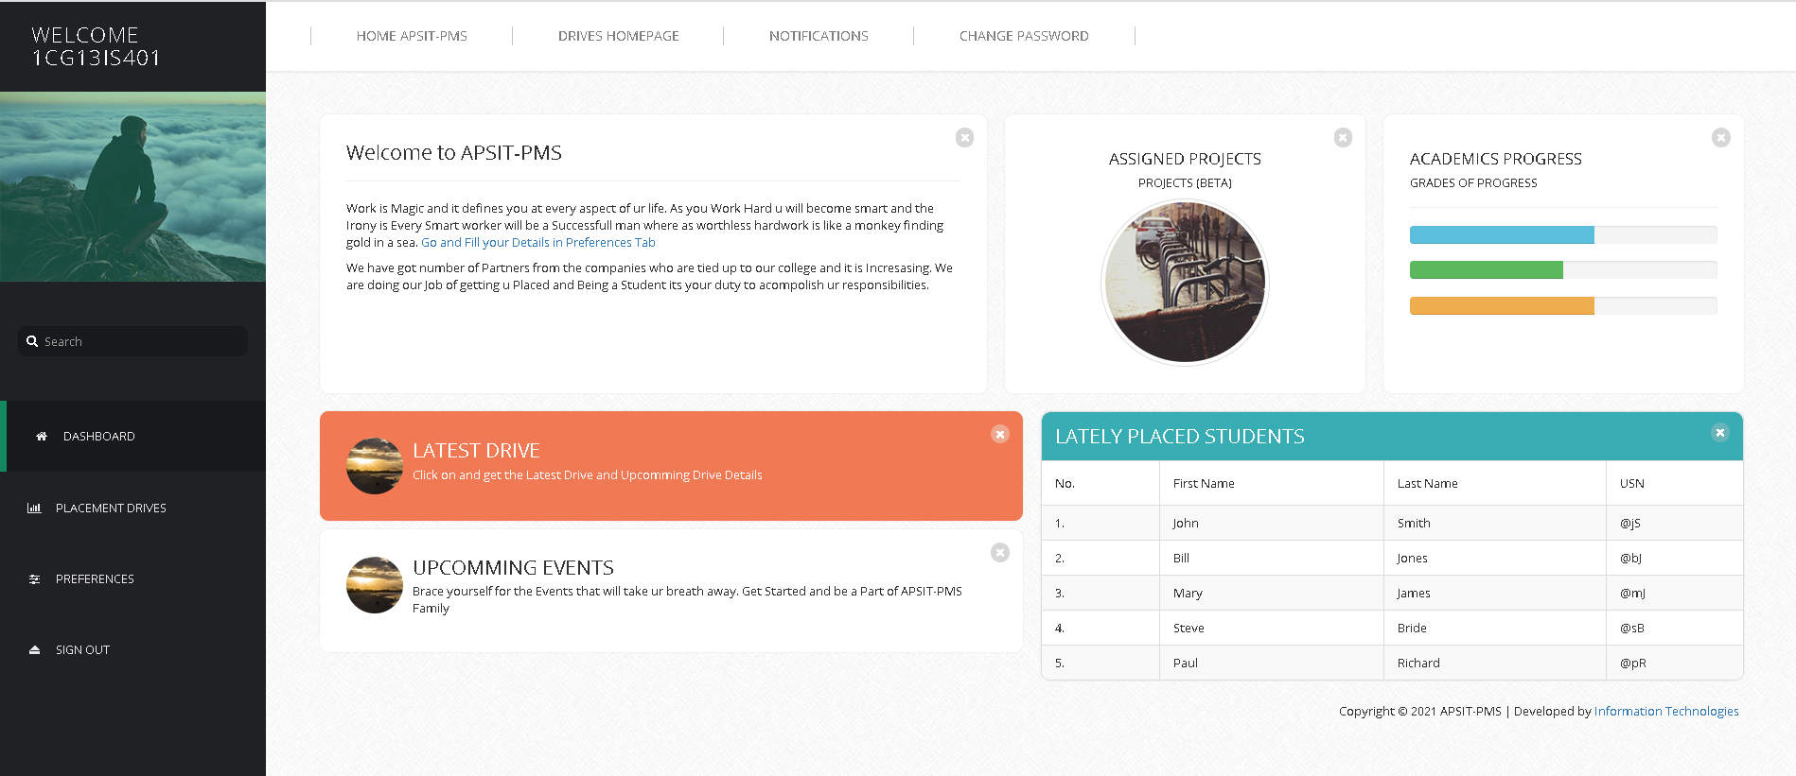
Module-3
Student-Dashboard

Slide 19
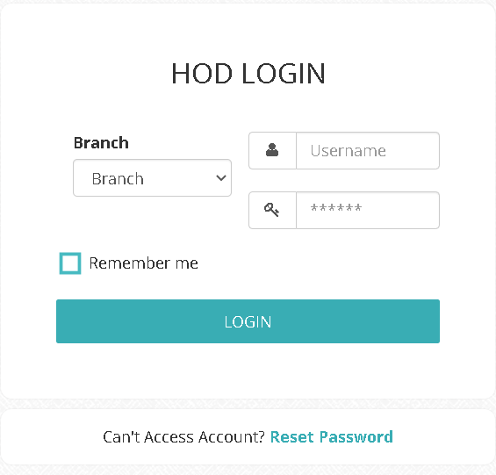
Module-4
HOD-login

Slide 20
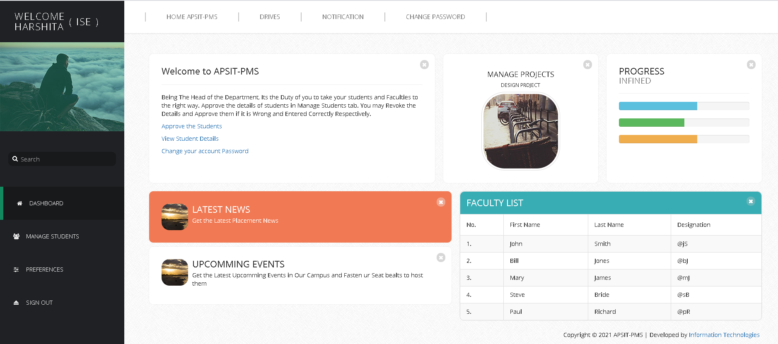
Module-5
HOD-dashboard

Slide 21
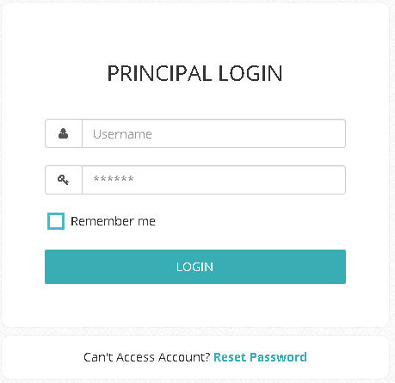
Module-6
Faculty-Login

Slide 22
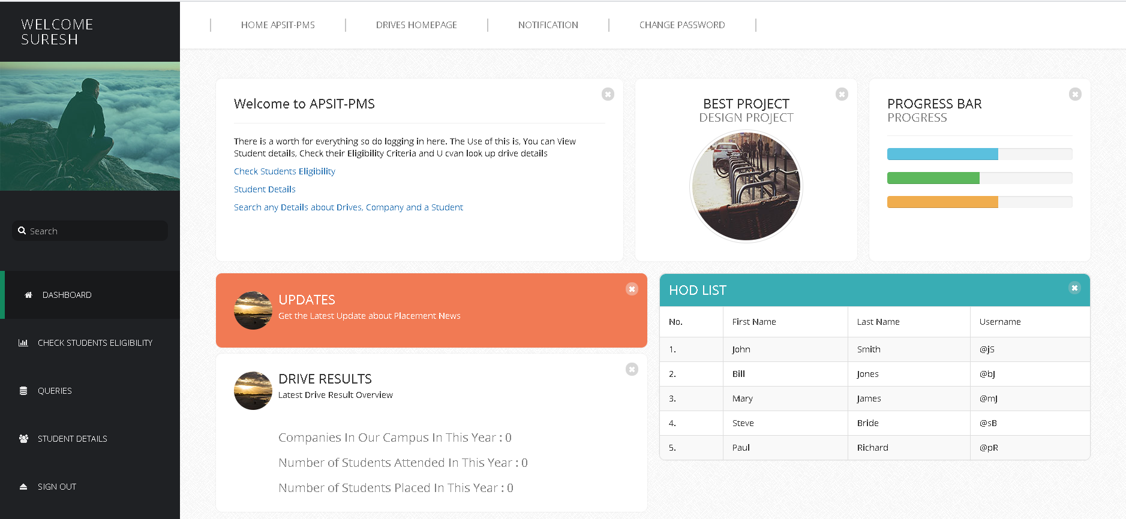
Module-7
Faculty-dashboard

Slide 23
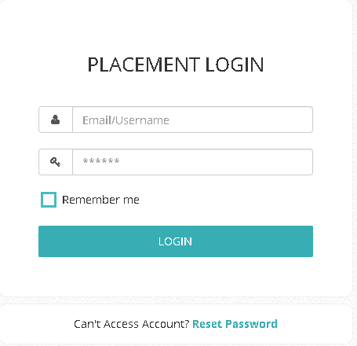
Module-8
Recruiter-login

Slide 24
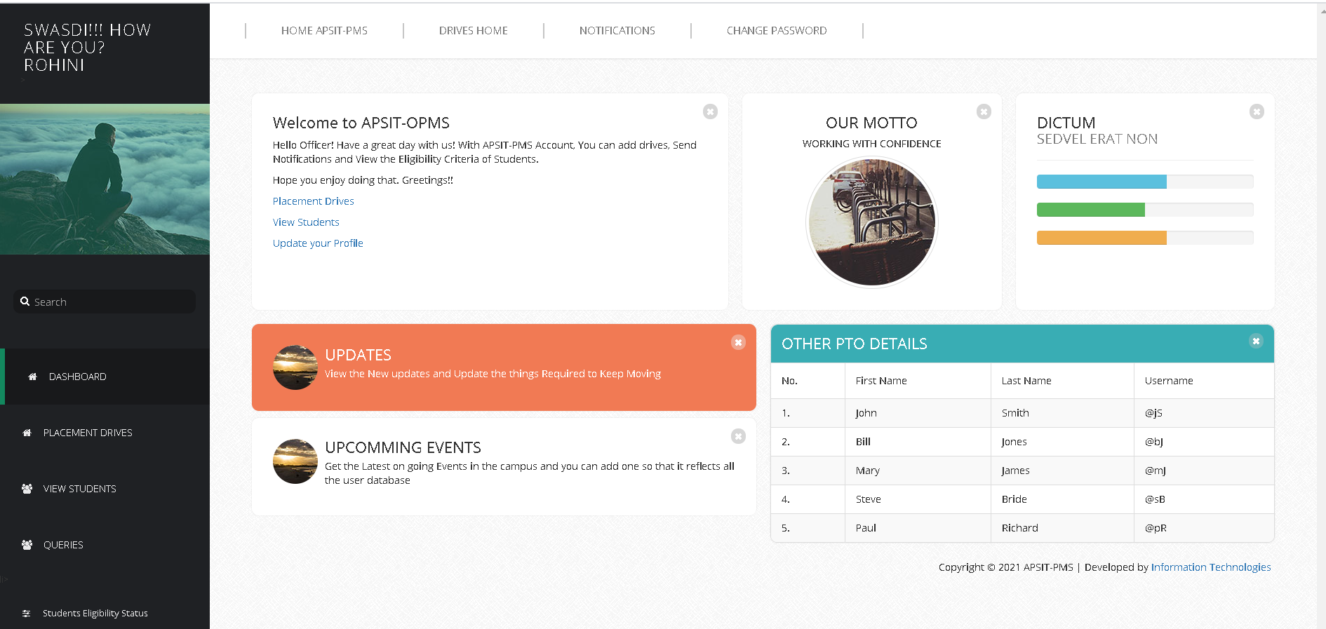
Module-9
Recruiter-dashboard

Slide 25
2.7 References
Large-Scale Dynamic Controller Placement Author: Web Based Placement Management System Year:2017
Web Based Placement Management System Author: Anjali.V, Jeyalakshmi.PR, Anbubala.R Year:2016
Design Paper on Online Training and Placement System(OTaP), Author: Mr. Nilesh T. Rathod,Prof. Seema Shah, Year:2013
Thereon Willis wrox publications (2000) - “Beginning SQL Server”.
www.java2s.comSQL introduction- Wikipedia, the free encyclopedia.

Slide 26
3. Conclusion and Future Scope

Slide 27
FUTURE SCOPE
In proposed placement system there is scope for improvement of the system. System is not providing the SMS integration. Hence, it can be modified to give the SMS integration. Apart from these there is scope for generating many more features. In the future we can place the system on the cloud so the maintenance of the data can be reduced. The Exam system will integrate with the online placement system so the student result can get directly. There can be many more future Enhancement & improvement in the Online Placement System.
CONCLUSION
In the existing Placement system, maximum work goes manually and it takes time for any changes in the system. This big problem is the searching; sorting and updating of the student data and no any notification method available for giving information to student except the notice board. Proposed system gets automated in the online registration all the user, activation of the user and deactivation of the user, personalization to the user, resources to be provided online, communication between the users, and gives online feedback. The admin can see the user information and will validate it, generate the student list on the basis of company criteria; company details can be provided to the user, searching and sorting can be done, and reports to be generated.

Slide 28
Thank You

